Slide 1
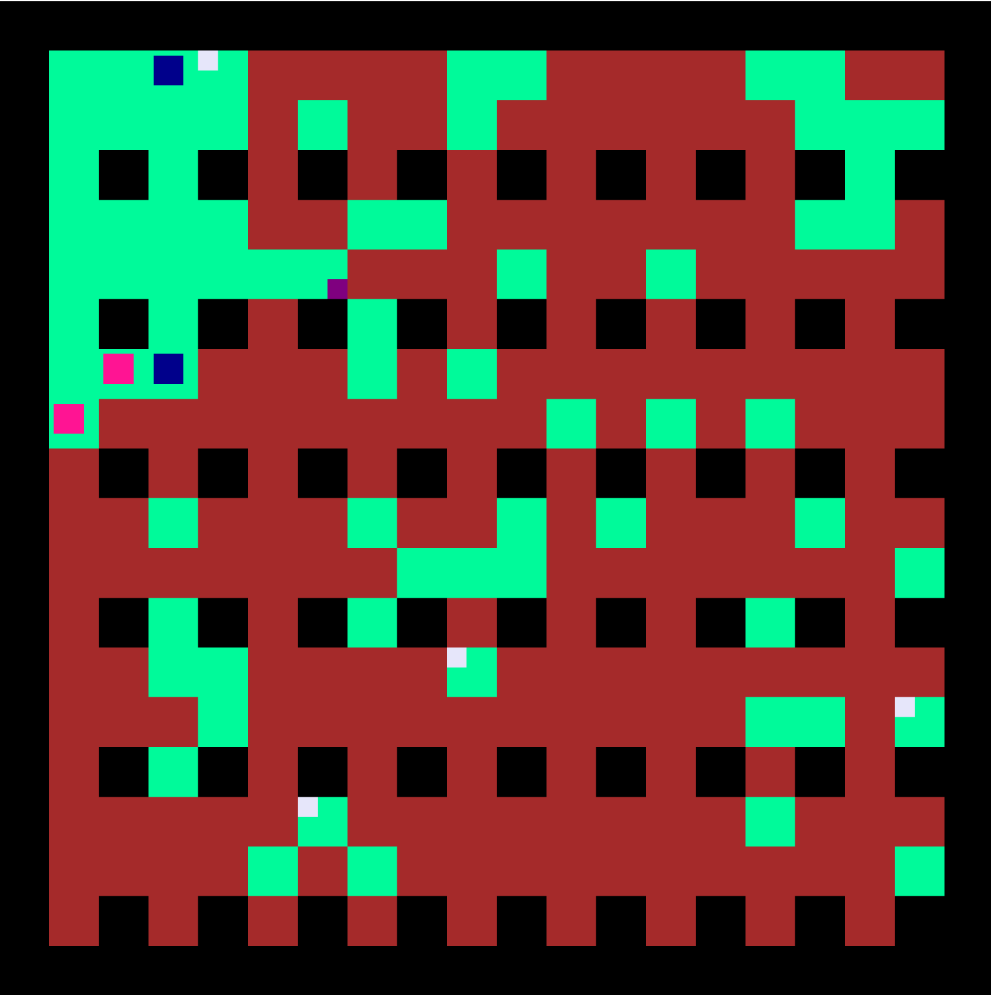
BombRadius Adder
Player
BombCounter Adder
Breakable block
Grass
Unbreakable block
Enemy

